Slide 1









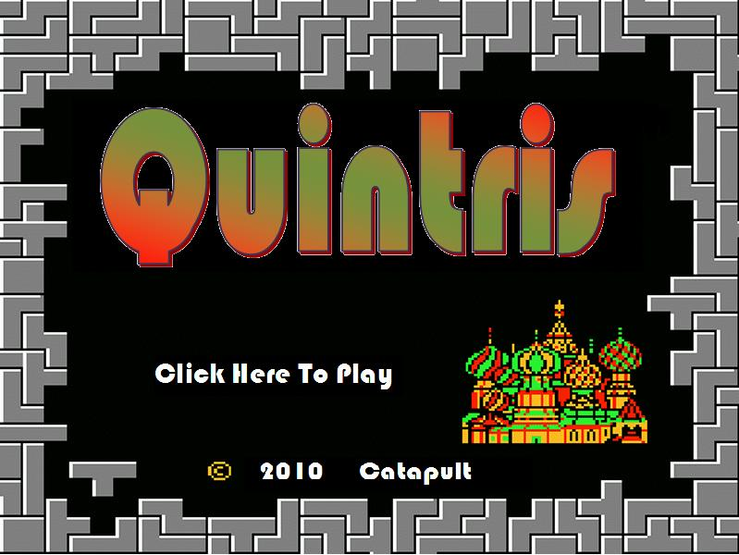
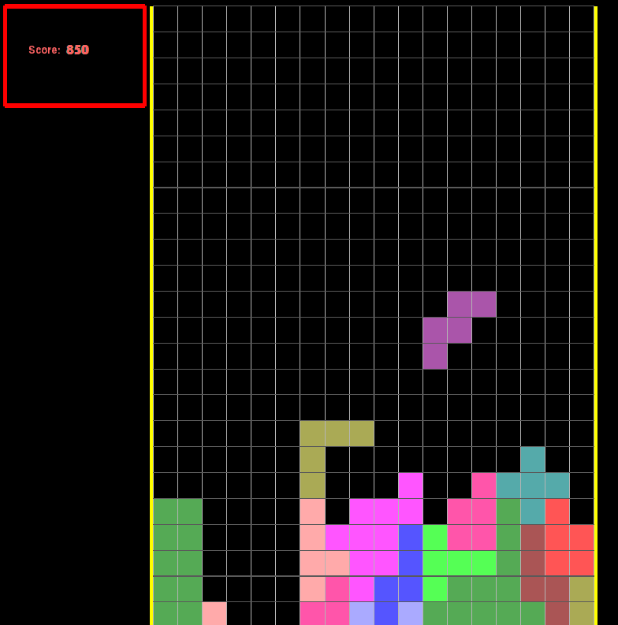
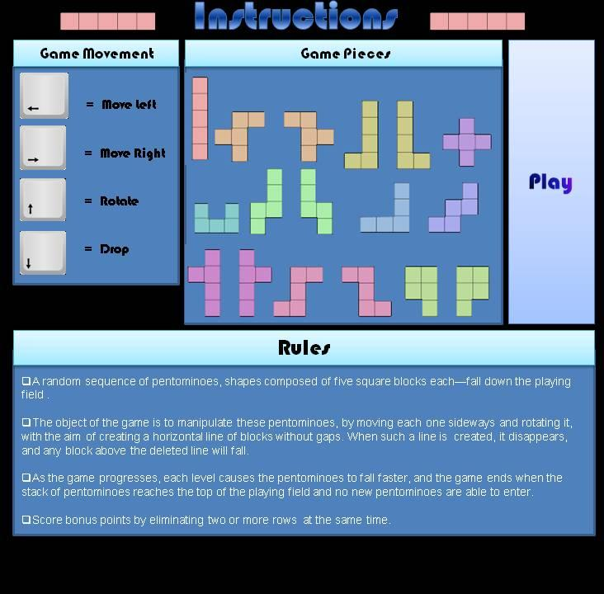



Team 30
Quintris
Operation Catapult
Features
Jason Kohl, Max Olivares, Spencer Smith, David Tran
Problems Encountered
Uses pentominoes in replacement of the original tetrominoes
Allows for the rotation of pentominoes
Free movement across the board and a quick-motion key for the advanced players to dominate the competition
Bigger game board for more fun and excitement.
Plan for double, triple, or more line busts to earn an even bigger bonus score!
Fall in love with your favorite childhood video game all over again, but enhanced!
Project Description
Creating extra pentominoes
Getting the pentominoes to have simultaneous x and y movement
Having the pentomino rotate in a fixed position by one key
Keeping the shapes from rotating out of the game board
Deleting a row and making the blocks above it fall after
Quintris is a strategic, puzzle game that requires the player to fit five-block shaped pieces together in complete rows in order to score points.
Falling pentominoes, five-blocked shapes, continue one after another while the user controls where the shape falls.
Freely move the pentominoes left and right and speed up the downward movement of the pentomino to play with a chance of gaining a bonus.
The objective of the game is to survive each level by not letting the pentominoes stack high enough to fill the screen
The more points scored can only help, as aiming for the number one rank is the most treasured objective in the game.
Get the classic feel of Tetris, but with tons of fun in an extensive game that will test the user’s skill and determination.
Screen Layouts
Conclusion
Future Improvements
In conclusion, the important aspects of Quintris were completed. Only few additional things were able to be added with the time. By using different methods in Python, we were able to finish what we intended too, with more to come in the future.
More levels of gameplay.
A multiplayer system, allowing two or more users to play on the same, or different computers.
More controls and methods to play the game.

